Slide 1
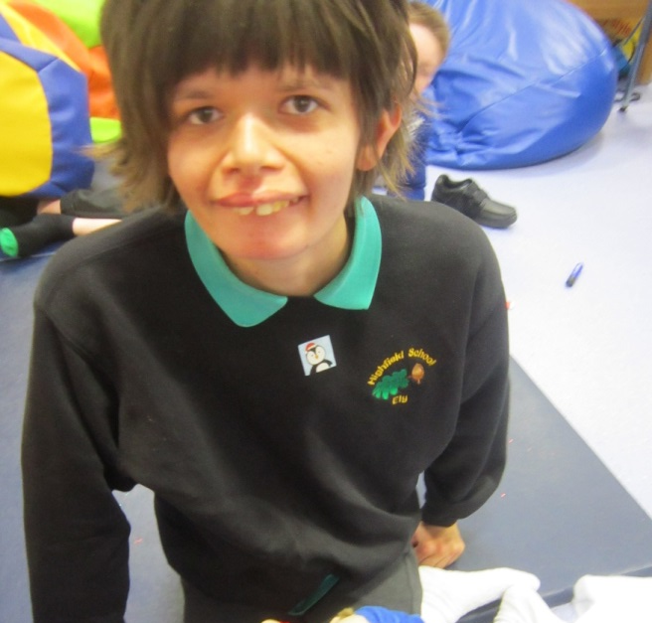
LINC19-25
Learning, Independence, Needs & Care
LINC19-25 is a new provision specifically suited to meet the needs of young adults with PMLD. This provision will initially be based at Highfield Littleport Academy and will move to Highfield Ely Academy in 2020.
LINC19-25 will offer specialist therapy services, such as Occupational Therapy and Physiotherapy and be able to meet the personal, daily and medical needs of young adults with PMLD.
We have a number of on-site facilities to support the learning and needs of our young adults:
on-site hydrotherapy pool
over-head tracking systems in all learning environments
dedicated changing rooms
access to specialist services such as Physiotherapy and Occupational Therapy
sensory garden
horticultural area
adapted kitchen and flat for lifelong learning activities
sports facilities
We will constantly track the progress of our young adults and offer accredited courses at LINC19-25. The exact program of study is mainly dependent on what has been studied prior to LINC 19-25. We can offer two accredited ASDAN courses: ASDAN Towards Independence and ASDAN Personal Progress.
Specialist learning provision for young adults with PMLD

